Slide 1


Problem Solving
How to Solve Problems
SoftUni Team
Technical Trainers
Software University
https://softuni.bg

Slide 2
Questions?
sli.do
#fund-common

Slide 3
Table of Content
What Is a Problem?
Stages of Problem Solving
Complexity of a Problem
Example Problems
From Chaotic to Methodological Approach

Slide 4

What Is a Problem?
Current and Desired State Diff

Slide 5

What Is a Problem?
Definition - a doubtful or difficult matter, requiring a solution
Goals - anything you wish to achieve, anywhere you want to be
Barriers - obstacles that prevent the achievement of goals
Without goals and barriers there is no problem

Slide 6

Stages
Stages of Solving a Problem

Slide 7
Solving a Problem
Define the problem
Analyse the problem
Identify potential solutions
Evaluate and choose the best solution
Plan action
Implement and review results

Slide 8
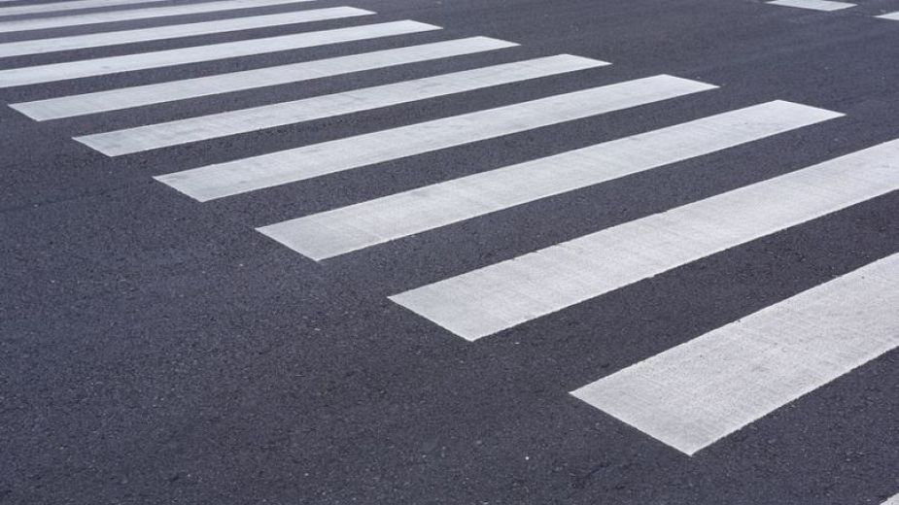
Problem Street Crossing
What are the steps to cross the street successfully ?

Slide 9
Problem Identification
Recognizing that there is a problem, identifying the nature of the problem, defining the problem
Ascertain the objective of the decision maker
Understand the background of the problem
Isolate and identify the problem
Determine the unit of analysis and the relevant variables
State and research the objective

Slide 10

Structure of the Problem
Observation
Inspection
Fact-finding
Developing a clear picture of the problem

Slide 11

Solutions and Decisions
Generating a range of possible courses of action and trying to evaluate them
Analyzing the different possible solutions and choosing the best one

Slide 12
Nine Dots Problem
Connect all the nine dots, using only 4 lines

Slide 13
Nine Dots Problem
Let's think outside the box!
What has changed?
Our point of view

Slide 14

Examples
Solving Problems

Slide 15
The Missing Piece

Slide 16

Five Gallons
You are mixing cement and the recipe calls for five gallons of water
You have a garden hose giving you all the water you need
The problem is that you only have a four-gallon bucket and a seven-gallon bucket and neither has graduation marks
Find a method to measure five gallons
7 gal
4 gal

Slide 17

10 Piles of 10 Coins One of Which Is Fake
You have 10 stacks of 10 gold coins
All the coins in one of these stacks are counterfeit, all the other coins are not
A real coin weighs 10 grams
A counterfeit coin weighs 11 grams
You can use an extremely accurate digital weighing machine only once
How do you determine which set of 10 coins is faulty?

Slide 18

Solutions

Slide 19
The Missing Piece

Slide 20
The Missing Piece
The gradient of the teal hypotenuse is different than the gradient of the red hypotenuse

Slide 21
Five Gallons
Fill the 4-gallon bucket
Empty the 4-gallon bucket into the 7-gallon bucket
Fill the 4-gallon bucket
Pour the 3 gallons from the 4-gallon bucket into the 7-gallon bucket
Empty the 7-gallon bucket
Pour the 1 gallon from the 4-gallon bucket into the 7-gallon bucket
Fill the 4-gallon bucket
Empty the 4-gallon bucket into the 7-gallon bucket
We have solved the problem
1 gal
7 gal
0 gal
1 gal
5 gal
0 gal
4 gal
4 gal

Slide 22

10 Piles of 10 Coins One of Which Is Fake (1)
We take one coin from pile #1, two coins from pile #2, three coins from pile #3 and so on until we have 10 coins from pile #10
This gives us 55 coins which if they were all pure would give us 550g

Slide 23
10 Piles of 10 Coins One of Which Is Fake (2)
However, some of them will be fake
Let's say we place them all on the scale, for our one and only weighing, and it reads 553g
The only possible way this could have happened is if we placed 3 counterfeit coins on the balance, and that means that pile #3 is counterfeit

Slide 24
Solving
From Chaotic to Methodological Approach

Slide 25
Read and Analyze the Problems
Consider you are at a computer programming exam or contest
You have 5 problems to solve in 6 hours
First read carefully all problems and try to estimate how complex each of them is
Read the requirements, don't invent them!
Start solving the easiest / fastest to solve problem first!
Leave the most complex / slow to solve problem last!
Approach the next problem when the previous is well tested

Slide 26

Use a Sheet of Paper and a Pen
Never start solving a problem without a sheet of paper + a pen
You need to sketch your ideas
Paper and pen is the best visualization tool
Allows your brain to think efficiently
Paper works faster than keyboard / screen
Other visualization tools could also work well

Slide 27
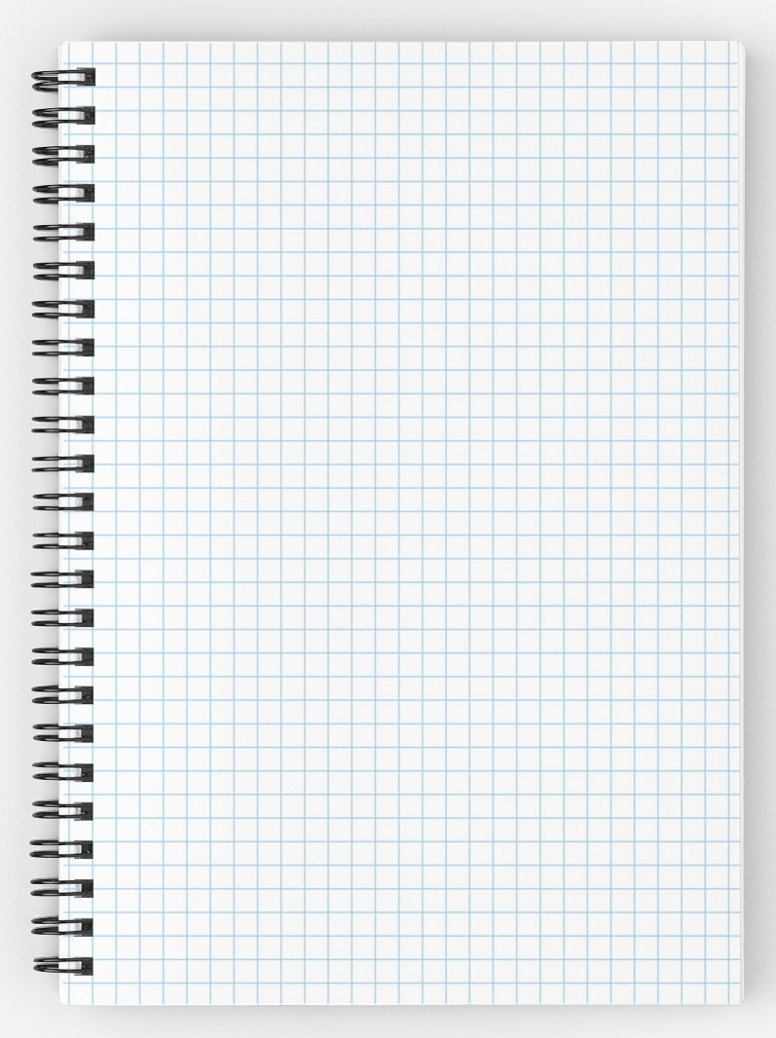
Prefer Squared Paper
Squared paper works best for algorithmic problems
Easy to draw a table
Easy to draw a coordinate system with objects at it
Easy to calculate distances
Easy to sketch a problem and solution idea

Slide 28
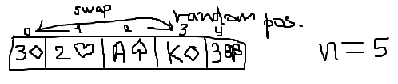
Paper and Pen
Consider a "Cards Shuffle" problem
We can sketch it to start thinking
Some ideas immediately come, e.g.
Split the deck into two parts and swap them multiple times
Swap 2 random cards a random number of times
Swap each card with a random card

Slide 29

Invent Ideas
Think-up, Invent Ideas and Check Them

Slide 30
Think Up, Invent and Try Ideas
First take an example of the problem
Sketch it on the sheet of paper
Next try to invent some idea that works for your example
Check if your idea will work for other examples
Try to find a case that breaks your idea
Try challenging examples and unusual cases
If you find your idea incorrect, try to fix it
Or just invent a new idea

Slide 31
Think Up, Invent and Try Ideas
Idea #1: random number of times split the deck into left and right part and swap them
How to represent the cards?
How to choose a random split point?
How to perform the exchange?
Idea #2: swap each card with a random card
How many times to repeat this?
Is this fast enough?

Slide 32
Think Up, Invent and Try Ideas
Idea #3: swap 2 random cards a random number of times
How to choose two random cards?
How many times to repeat this?
Idea #4: choose a random card and insert it in front of the deck
How to choose random card?
How many times to repeat this?
Idea #5: do you have another idea?

Slide 33

Divide and Conquer
Decompose Problems into Manageable Pieces

Slide 34
Decompose the Problem
Work decomposition is natural in engineering
It happens every day in the industry
Projects are decomposed into subprojects
Complex problems could be decomposed into several smaller sub-problems
Technique known as "Divide and Conquer"
Small problems could easily be solved
Smaller sub-problems could be further decomposed as well

Slide 35
Divide and Conquer – Example
Let's try idea #1:
Split the deck into left and right part and swap them (many times)
Divide and conquer
Sub-problem #1 (single exchange) – split the deck into two random parts and exchange them
Sub-problem #2 – choosing a random split point
Sub-problem #3 – combining single exchanges
How many times to perform "single exchange"?

Slide 36
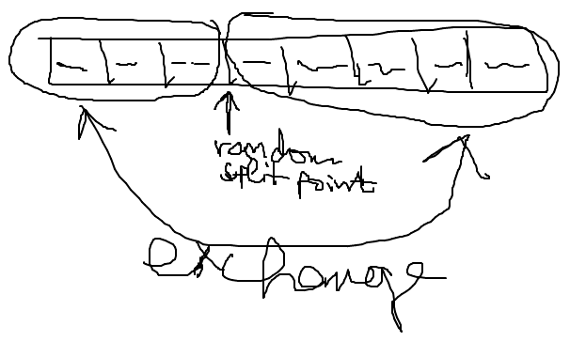
Sub-Problem #1 (Single Exchange)
Split the deck into two parts at random split point
And exchange these 2 parts
We visualize this by paper and pen:

Slide 37
Sub-Problem #2 (Single Exchange)
Choosing a random split point
Need to understand the concept of pseudo-random numbers and how to use it
In Internet lots of examples are available, some of them incorrect
The class System.Random can do the job
Important detail is that the Random class should be instantiated only once
Not at each random number generation

Slide 38
Sub-Problem #3 (Single Exchange)
Combining a sequence of single exchanges to solve the initial problem
How many times to perform single exchanges to reliably randomize the deck?
N times (where N is the number of the cards) seems enough
We have an algorithm:
N times split at random position and exchange the left and right parts of the deck

Slide 39

Check-Up Your Ideas
Don't Go Ahead Before Checking Your Ideas

Slide 40
Check-Up Your Ideas
Check-up your ideas with examples
It is better to find a problem before the idea is implemented
When the code is written, changing your ideas radically costs a lot of time and effort
Carefully select examples for check-up
Examples should be simple enough to be checked by hand in a minute
Examples should be complex enough to cover the most general case, not just an isolated case

Slide 41
Check-Up Your Ideas – Example
Let's check the idea:
After 3 random splits and swaps we obtain the start position
Seems like a serious problem!

Slide 42
Invent New Idea If Needed
What to do when you find your idea is not working in all cases?
Try to fix your idea
Sometimes a small change could fix the problem
Invent new idea and carefully check it
Iterate
Usually your first idea is not the best
Invent ideas, check them, try various cases, find problems, fix them, invent better ideas, etc.

Slide 43
Invent New Ideas – Example
Invent a few new ideas:
New idea #1 – multiple times select 2 random cards and exchange them
New idea #2 – multiple times select a random card and exchange it with the first card
New idea #3 – multiple times select a random card and move it to an external list
Let's check the new idea #2
Is it correct?

Slide 44
Check-Up the New Idea – Example

Slide 45

Implementation
Coding and Testing Step-By-Step

Slide 46
Start Coding: Checklist
Never start coding before you find a correct idea that will meet the requirements
What shall you write before you have a correct idea?
Checklist to follow before start of coding:
Ensure you understand the requirements well
Ensure you have come up a good idea
Ensure your idea is correct
Ensure you know what data structures to use
Ensure the performance will be sufficient

Slide 47
Implement Your Algorithm Step-By-Step
"Step-by-step" approach is always better than "build all, then test"
Implement a piece of your program and test it
Then implement another piece of the program and test it
Finally put together all pieces and test it
Small increments (steps) reveal errors early
"Big bang" integration takes more time

Slide 48

Testing the Code
Thoroughly Test Your Solution

Slide 49
Thoroughly Test Your Solution
Always test thoroughly your solution
Invest in testing!
One 90-100% solved problem could be better than 2 or 3 partially solved
Testing an existing problem takes less time than solving another problem from scratch

Slide 50
How to Test?
Testing could not certify absence of defects
It just reduces the defects’ rates
Well tested solutions are more likely to be correct
Start testing with a good representative of the general case
Not a small isolated case, but a typical one
Large enough test case, but small enough to be easily checkable

Slide 51
Read the Problem Statement
Read carefully the problem statement
Does your solution print exactly what is expected?
Does your output follow the requested format?
Did you remove your debug printouts?
Be sure to solve the requested problem, not the problem you think is requested!
Example: "Write a program to print the number of permutations of n elements" means to print a single number, not a set of permutations!

Slide 52

Summary
Problem solving needs methodology:
Understanding and analyzing problems
Using a sheet of paper and a pen for sketching
Thinking up, inventing and trying ideas
Decomposing problems into sub-problems
Selecting appropriate data structures
Thinking about the efficiency and performance
Implementing step-by-step
Testing the nominal case, border cases and efficiency
…
…
…

Slide 53
https://softuni.bg/courses/programming-fundamentals

Slide 54












SoftUni Diamond Partners

Slide 55




SoftUni Organizational Partners

Slide 56




Trainings @ Software University (SoftUni)
Software University – High-Quality Education and Employment Opportunities
softuni.bg
Software University Foundation
http://softuni.foundation/
Software University @ Facebook
facebook.com/SoftwareUniversity
Software University Forums
forum.softuni.bg

Slide 57

License
This course (slides, examples, demos, videos, homework, etc.) is licensed under the "Creative Commons Attribution-NonCommercial-ShareAlike 4.0 International" license

